Slide 1
Predicting employee lTurnover
Mohammad Bakir
Notes:
Good morning everyone, my name is Mohammad Bakir, and I am here to talk about my Employee Attrition predicting model. Lets start with why is employee attrition important.

Slide 2




Why Is Employee Turnover Important?
Annual Cost
1
Development
150 Person Company
With
11% Annual Turnover
$10K
$1.57
Million
Costs
Lost Opportunity
Hiring
$25K
$50K
1 Center for American Progress | There Are Significant Business Costs to Replacing Employees
Notes:
A recent paper from the Center for American Progress, determine that the average economic cost to 150 person company with 11% annual turnover was 1.57 Million taking into consideration hiring, development/training and lost opportunity is $1.57 million dollar in annual costs.

Slide 3
Process Pipeline
Data Collection and Pre-Processing
EDA / Feature Transformations
Model Training / Validation
Deployment
Notes:
In order to attack this problem and to develop my product, my approach was to first collect employee attrition data. This data was obtained from Kaggle

Slide 4



Data Collection / Cleaning – IBM Kaggle Dataset
Reduced To
20
Comprehensive Interpretable Employee Categories
35+
Feature Categories
Uncovering Factors Leading To Employee Attrition
Tools Used
Notes:
I chose a data set developed by IBM data scientist, the data contained over 35 employee feature categories to which I reduced down to 20 comprehensive categories.

Slide 5
Process Pipeline
Data Collection and Pre-Processing
EDA / Feature Transformations
Model Training / Validation
Deployment
Notes:
The next step in my process was to analyze my data

Slide 6
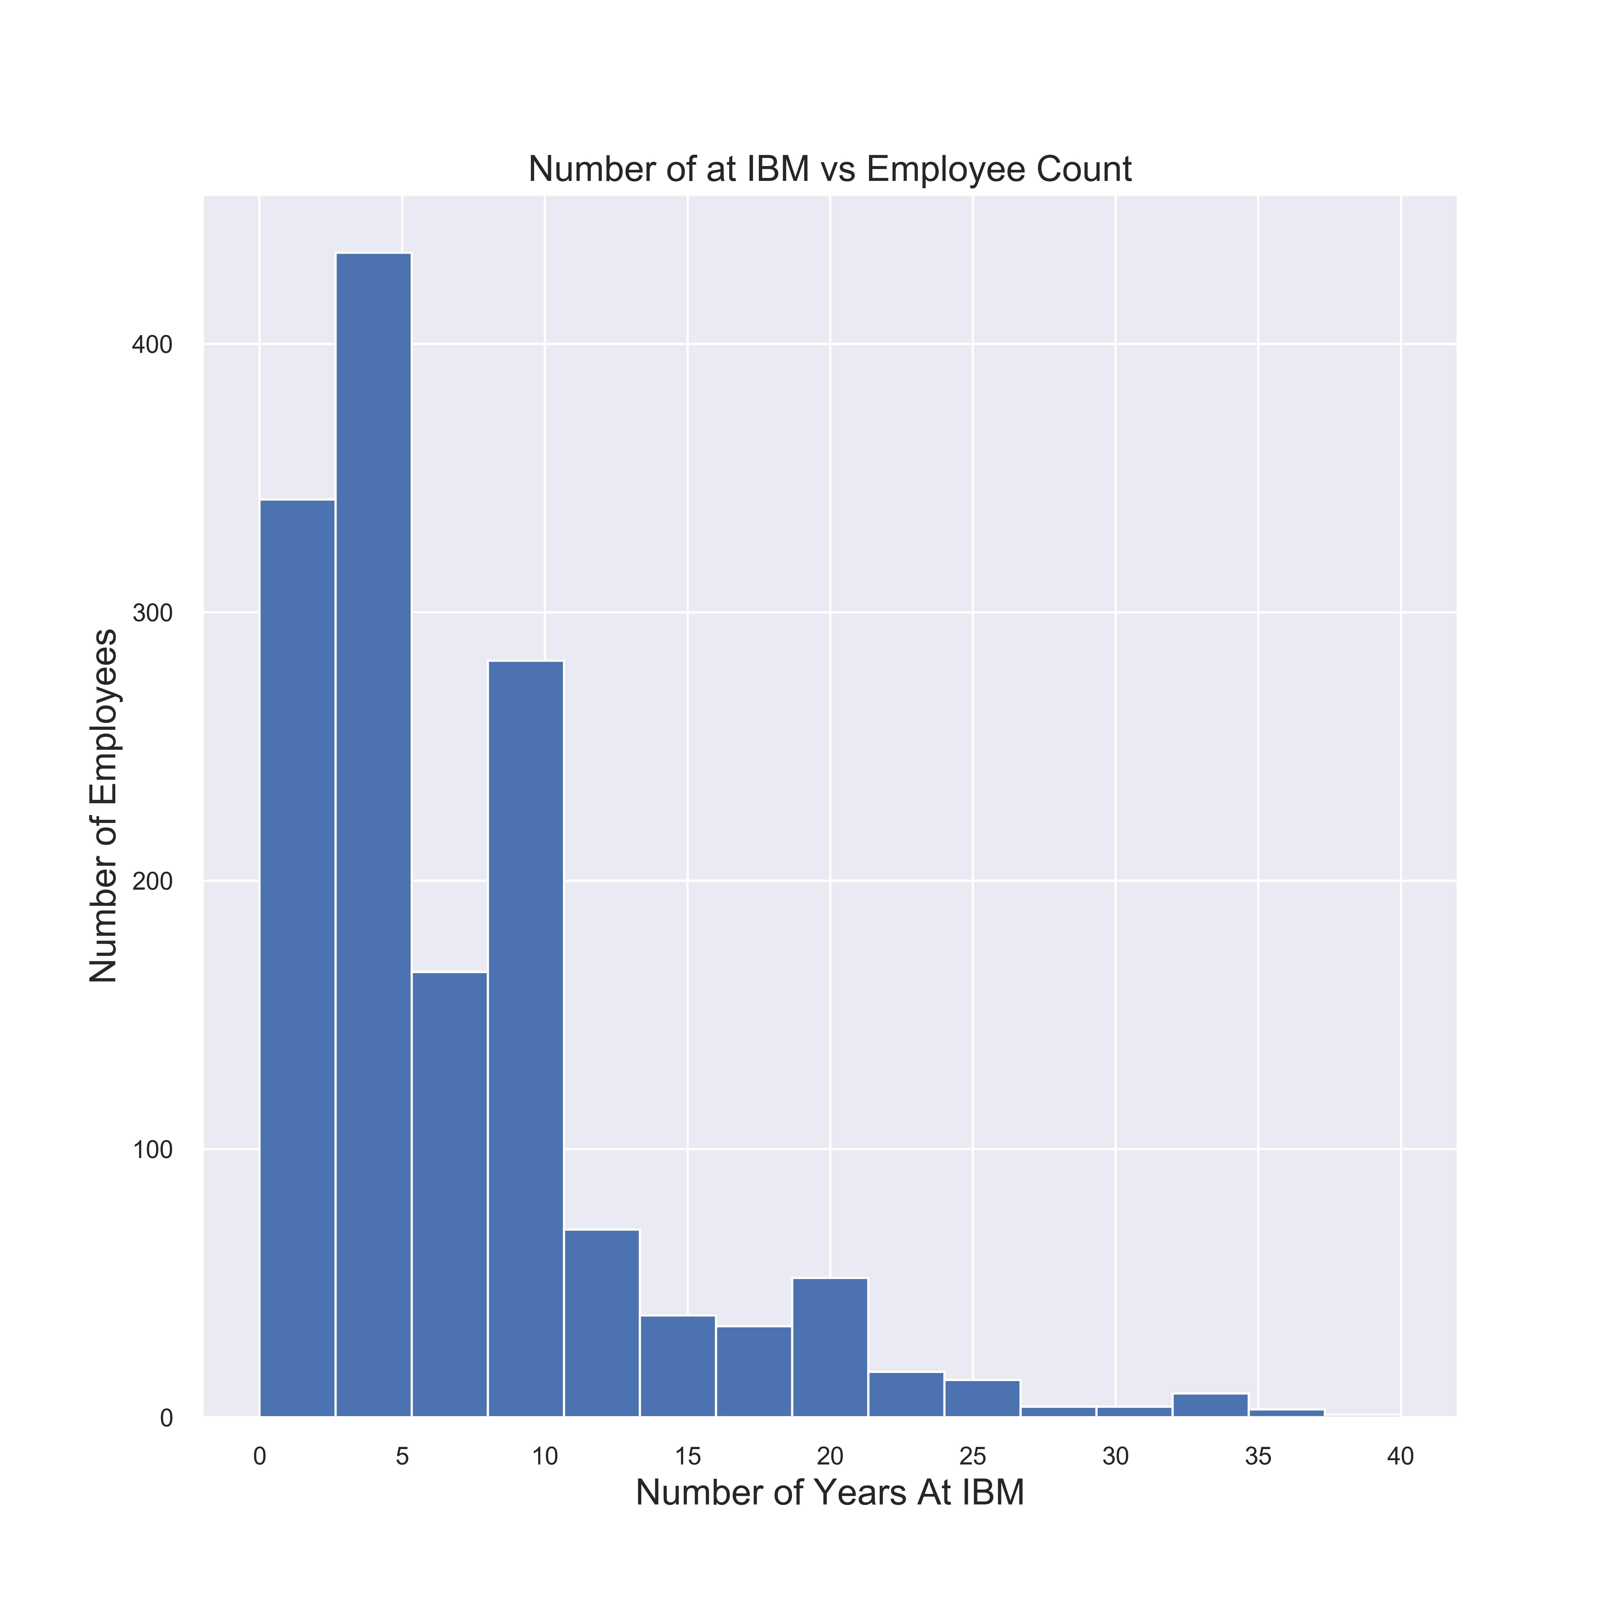
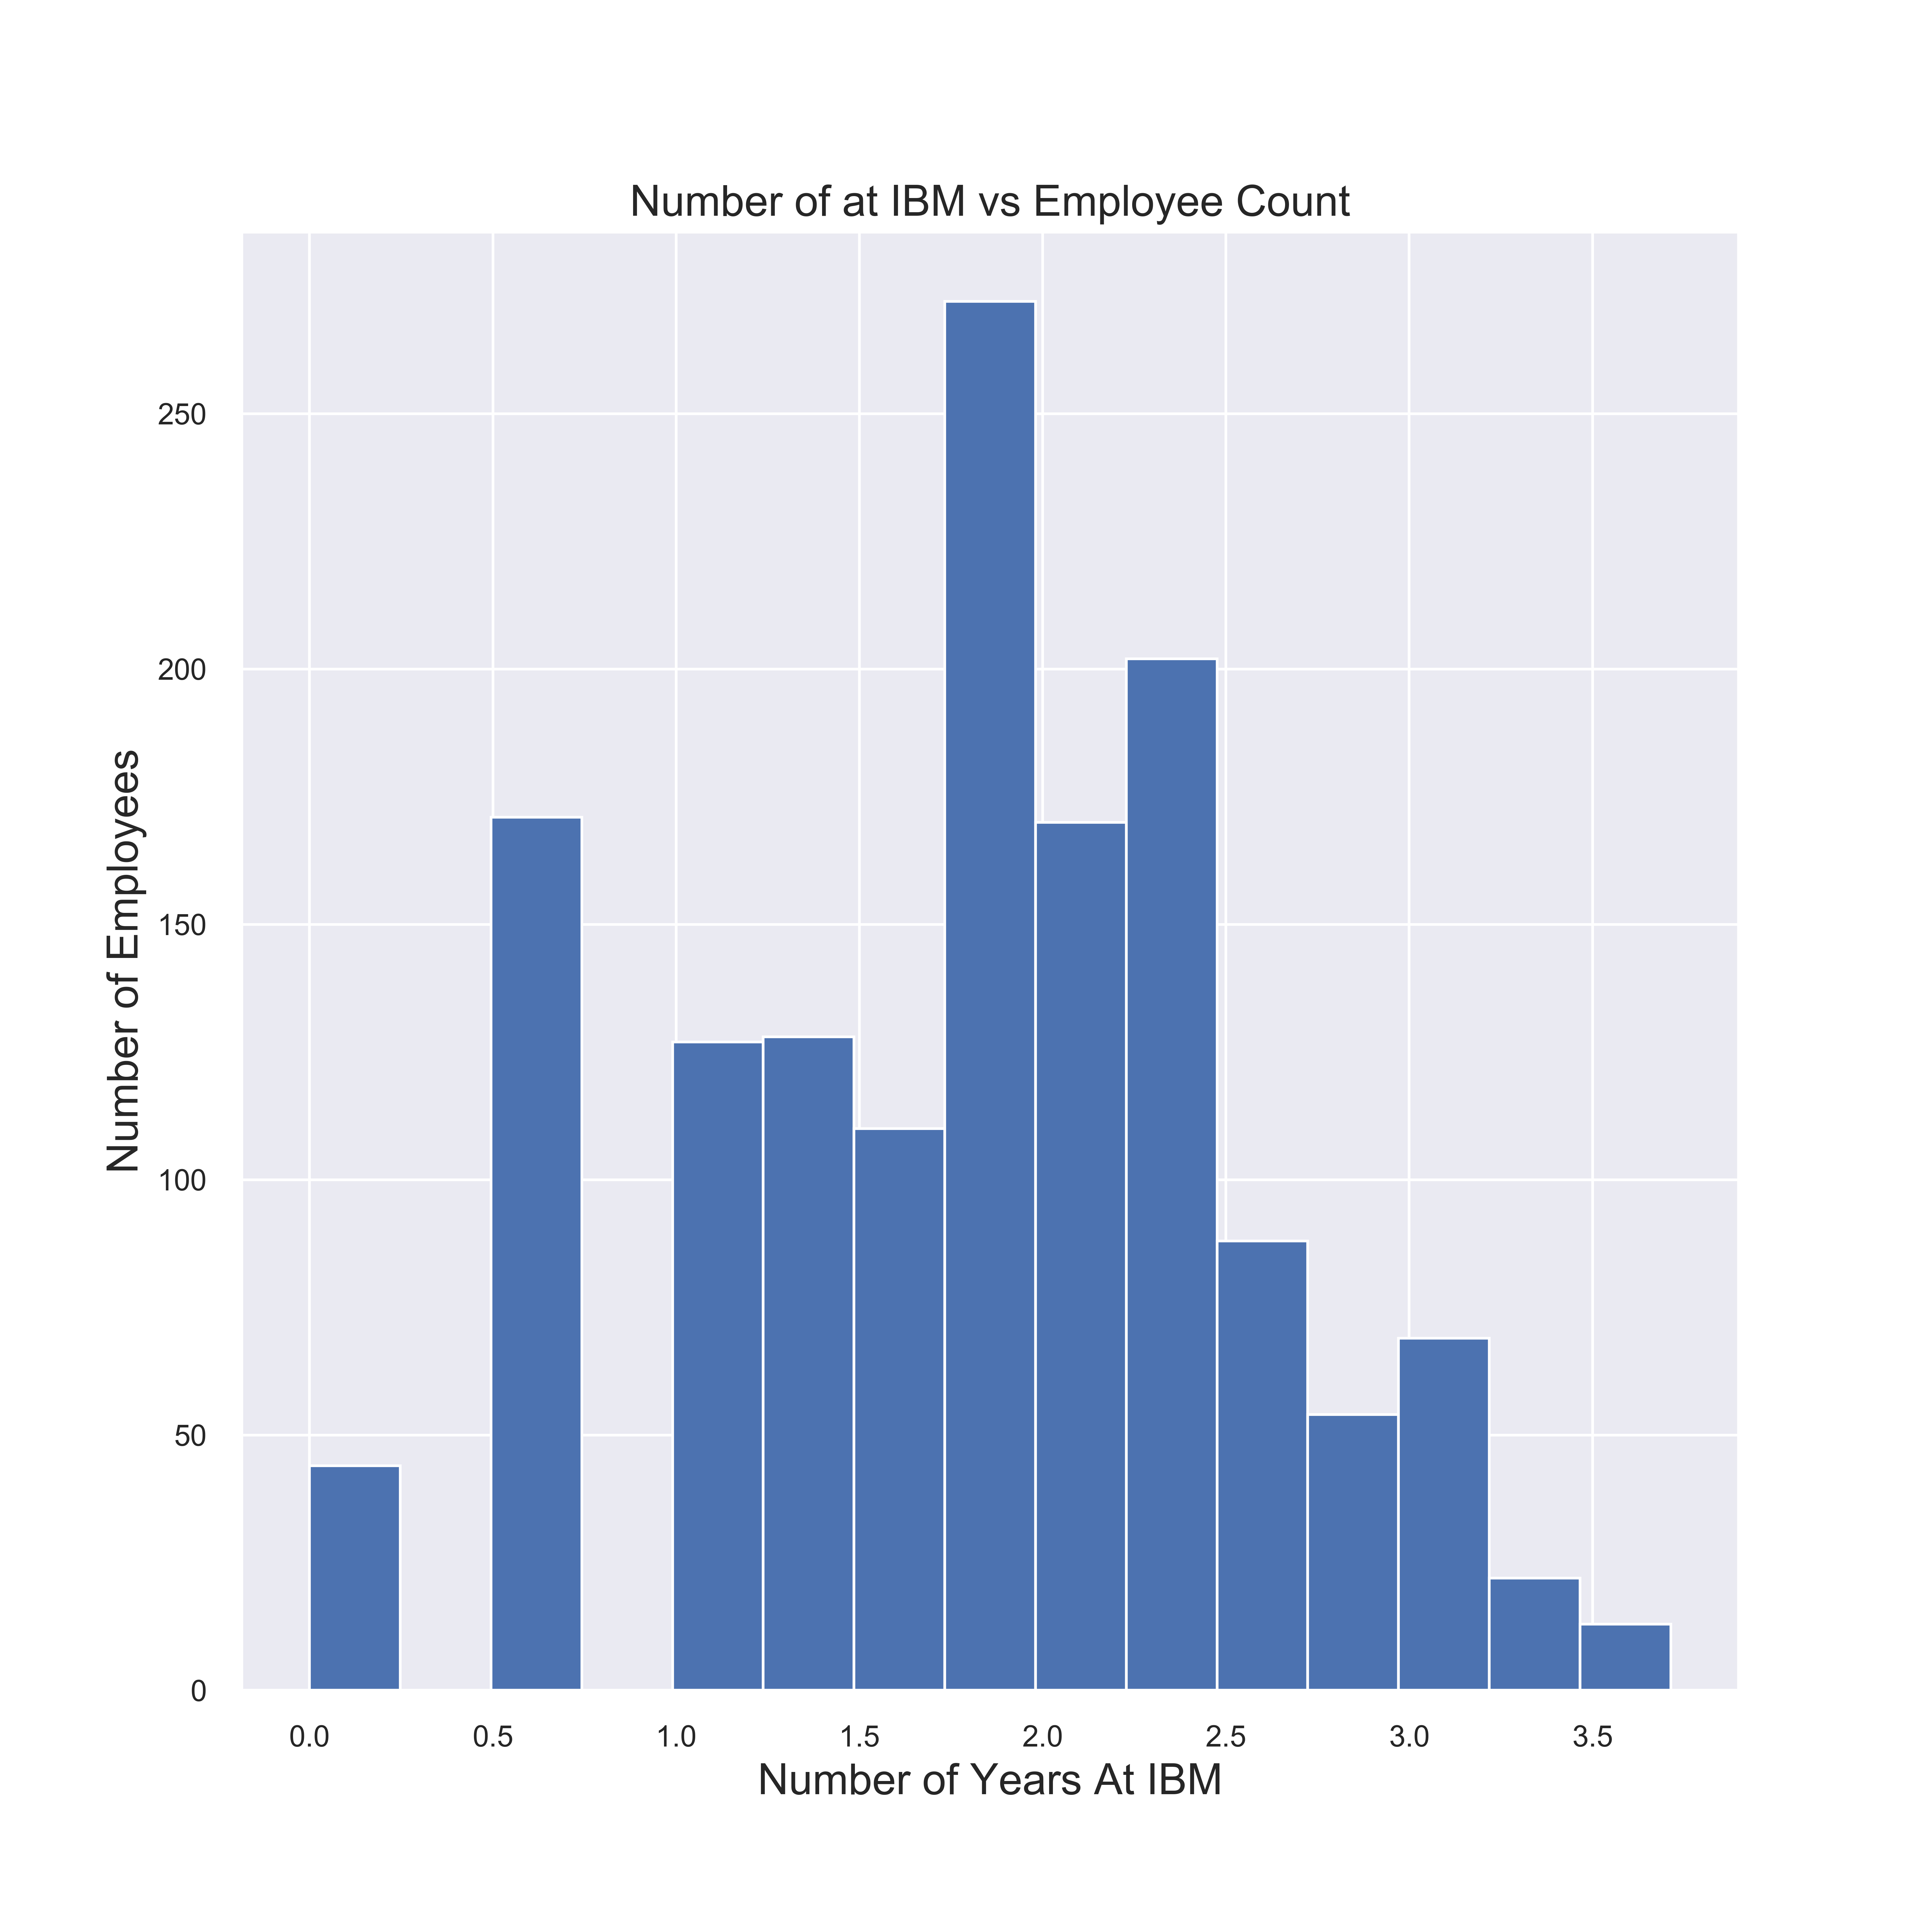
Feature Transformation’s
Normalizing Data
- Log Transform
One Hot Encoding
- Categorical Value
Representation
Standardize Data
- Feature Scaling
Notes:
I transformed a few features to follow a uniform normal distribution, one hot encoded categorical value representations and standardized data using feature scaling.

Slide 7
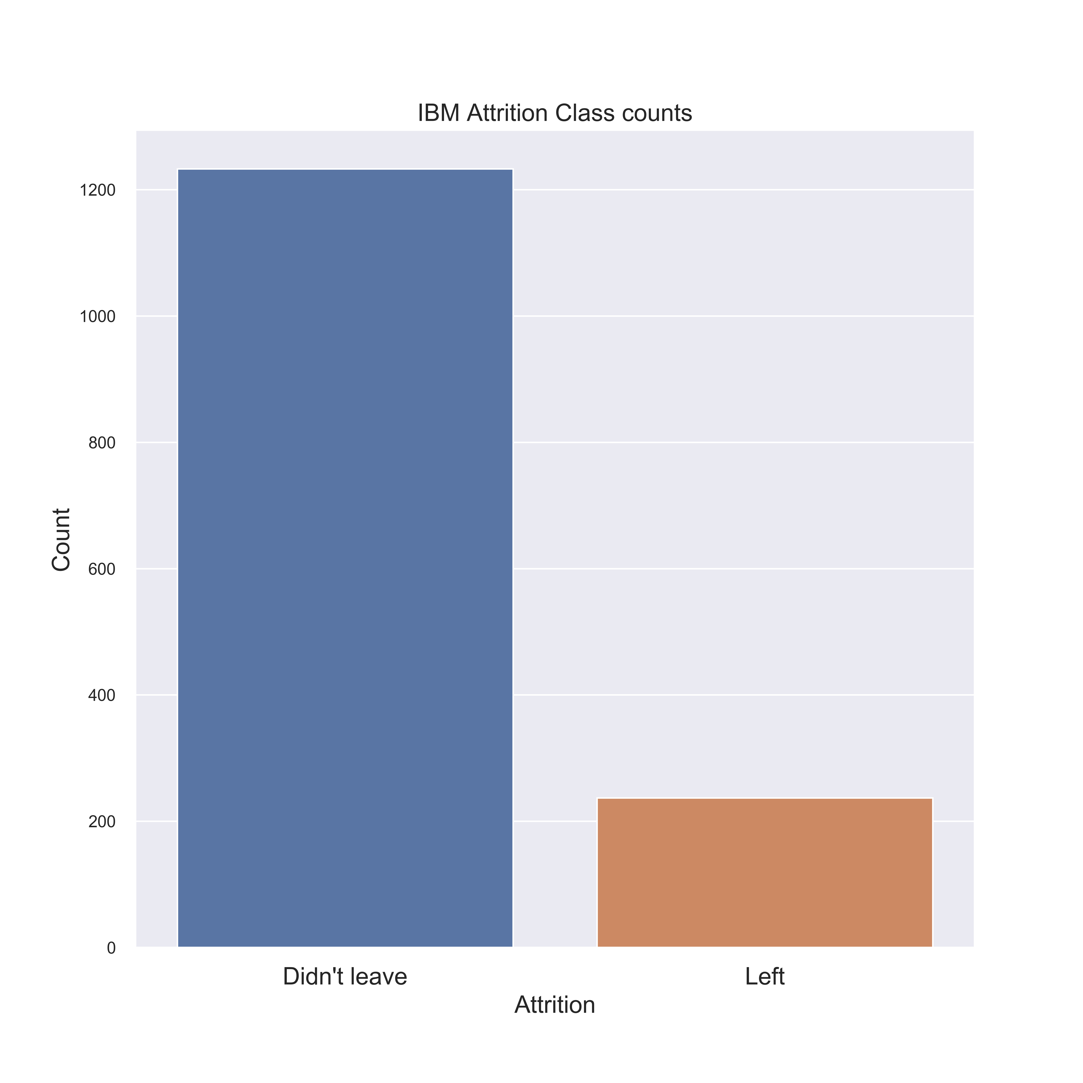
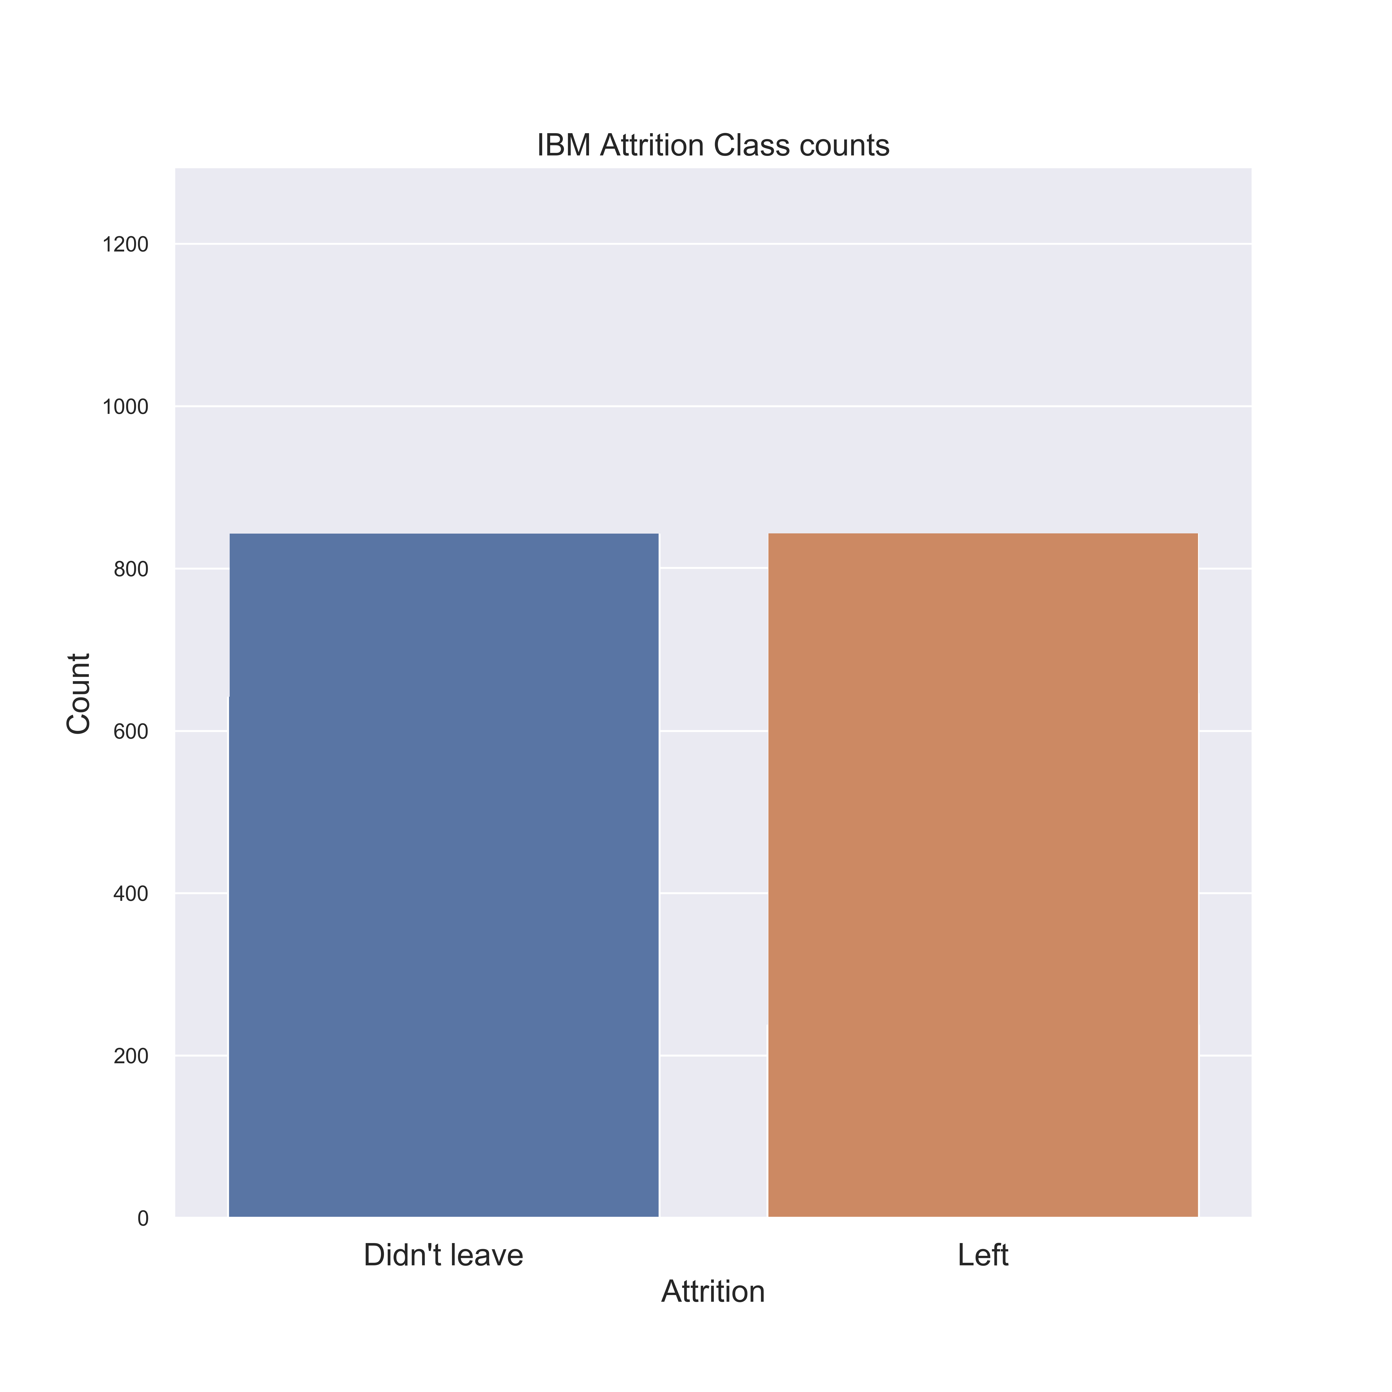
Class Balancing
Notes:
As the graph on the left shows, we have an imbalanced dataset. In order to deal with this, during training I chose to balance class by replicating the smaller class until it has as many samples as in the larger one.

Slide 8
Process Pipeline
Data Collection and Pre-Processing
EDA / Feature Transformations
Model Training / Validation
Deployment
Notes:
The next step in my process was to develop some base line models.

Slide 9
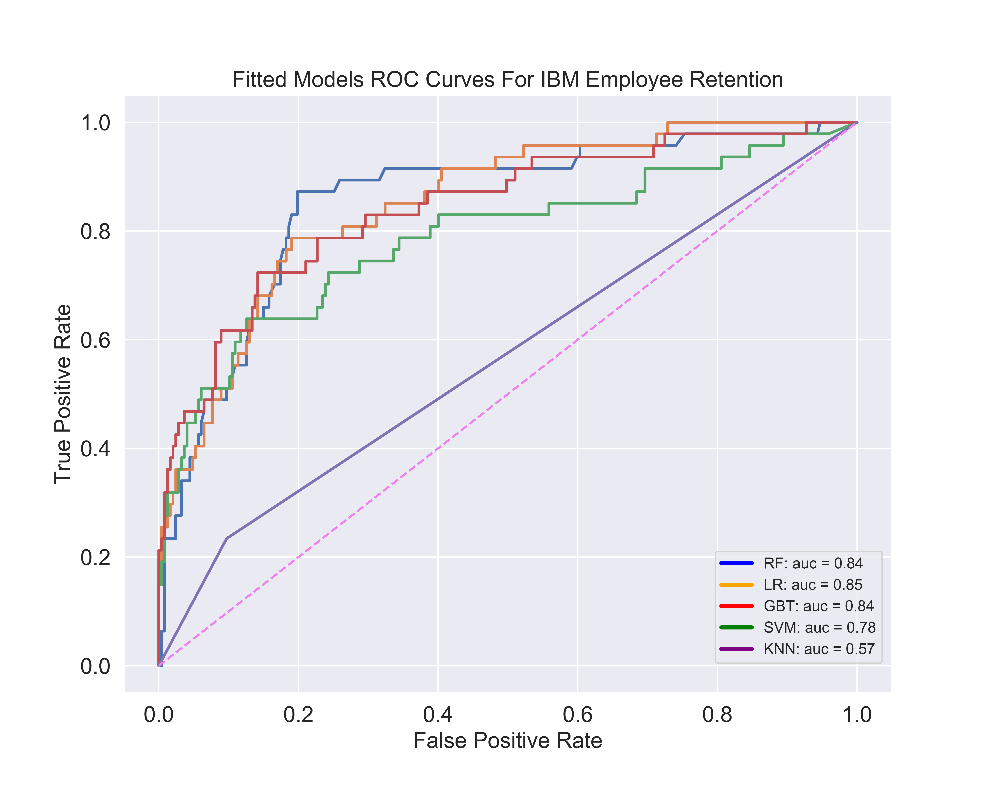
Modeling
LR
RF
Model | Precision | Recall
Random Forest | 0.56 | 0.75
Gradient Boosting Trees | 0.52 | 0.62
Logistic Regression | 0.36 | 0.81
Support Vector Machine | 0.57 | 0.51
K-Nearest Neighbor | 0.31 | 0.23
Notes:
For my modeling, I wanted to know that when an employee left, how often does my model predict that correctly, also known as recall of a model, I chose this parameter to determine which of my baseline models would work best for me.
To the left you see various plots of the individual models ROC curves. An ROC curve tells us ‘How much a model is capable of distinguishing between classes’. By analogy, the higher the AUC, the better the model is at distinguishing between Employees who leave and those who don’t. The two models with the highest ROC are Random Forest and LR. These two models also had the highest recall values. I chose to move forward with random forest due to its versatility, and it can sometimes be expected to outperform LR on medium-sized tasks.

Slide 10
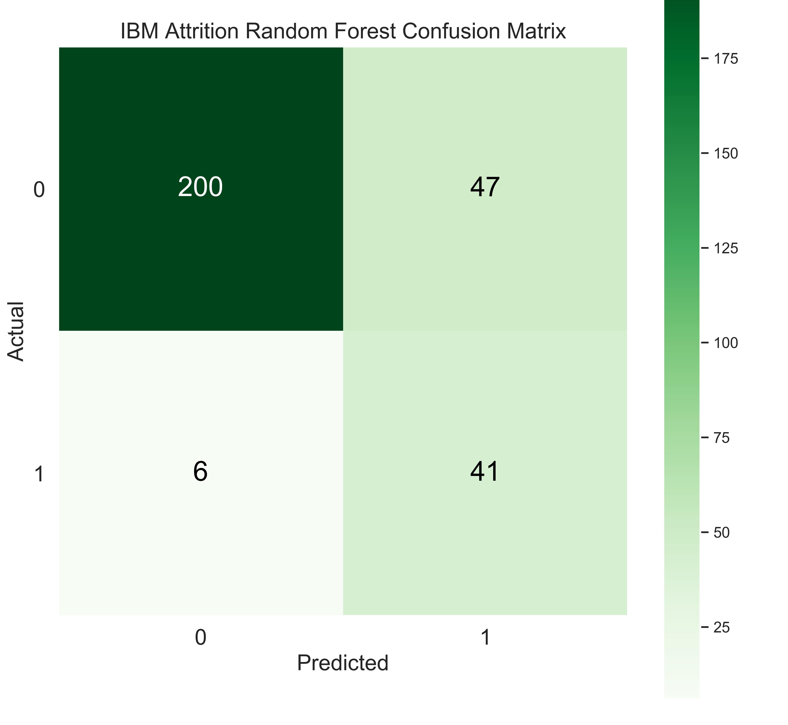
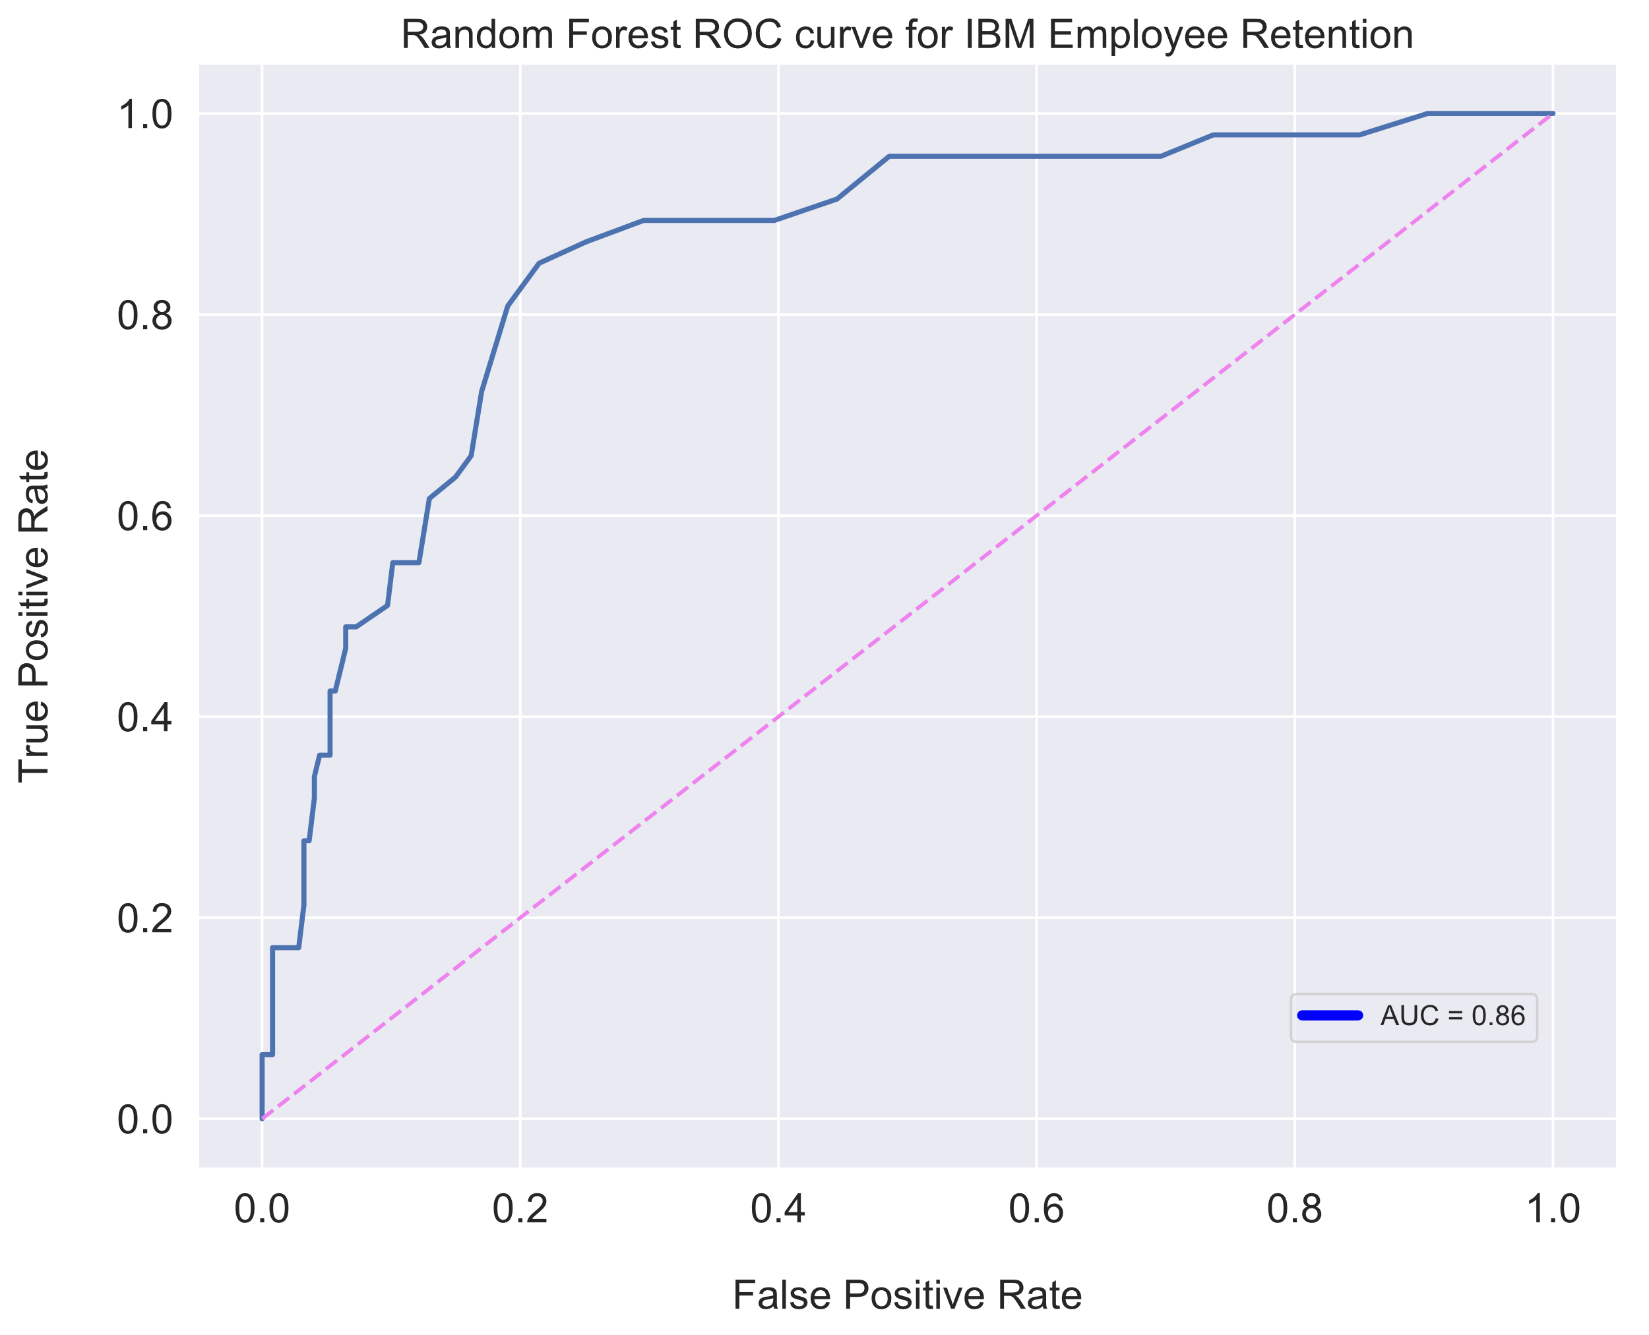
Modeling – Post Tuning
Precision | Recall
47% | 87%
(Didn’t Leave)
(Left)
Notes:
After tuning my model I achieved better recall results, take a quick look at the diagram on the left which demonstrates that random forest is a great model for our recall criteria. Out of all the turnover cases, random forest correctly retrieved 41 out of 47 Cases. This translates to a turnover recall of about 87%. I was also able to improve my AUC score to 0.86, a 2.5% increase in my models ability to distinguish between my two classes.

Slide 11
Process Pipeline
Data Collection and Pre-Processing
EDA / Feature Transformations
Model Training / Validation
Deployment
Notes:
Now that I have my model lets talk about its deployment.

Slide 12
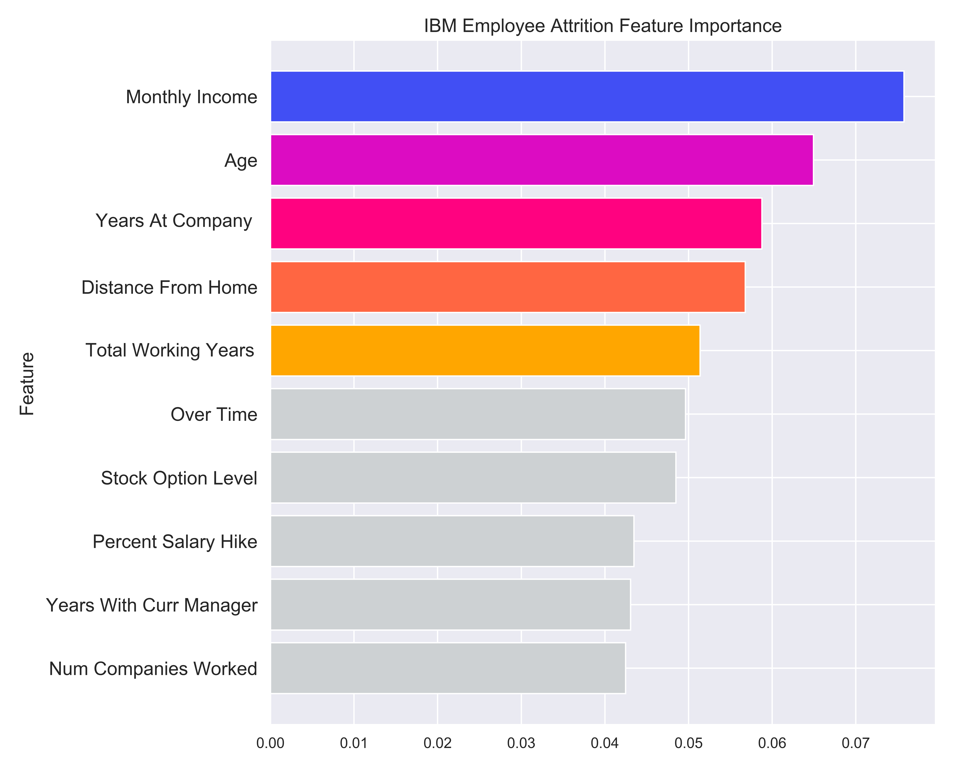
Deployment - Feature Importance
Feature | Ranking
Monthly Income | 1
Age | 2
Years At Company | 3
Distance From Home | 4
Total Working Years | 5
Overtime Work | 6
Stock Option Level | 7
Percent Salary Hike | 8
Years with Current Manager | 9
Number of Companies Worked | 10
Notes:
This slide shows a graph of my top 10 features as predicted by model, with Monthly Income, Age, Years At Company, Distance from Home, and Total Working Years being the top 5.

Slide 13
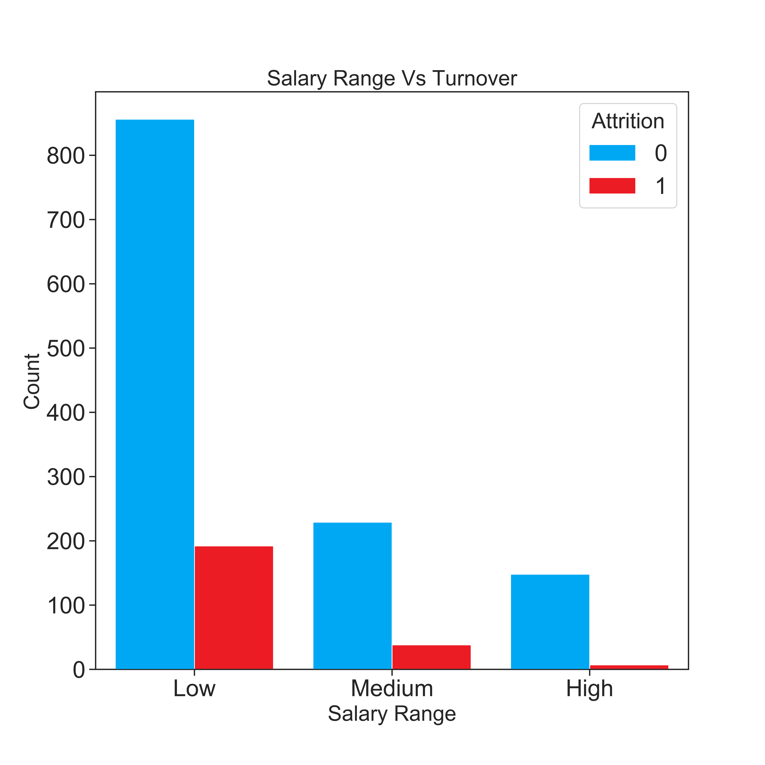
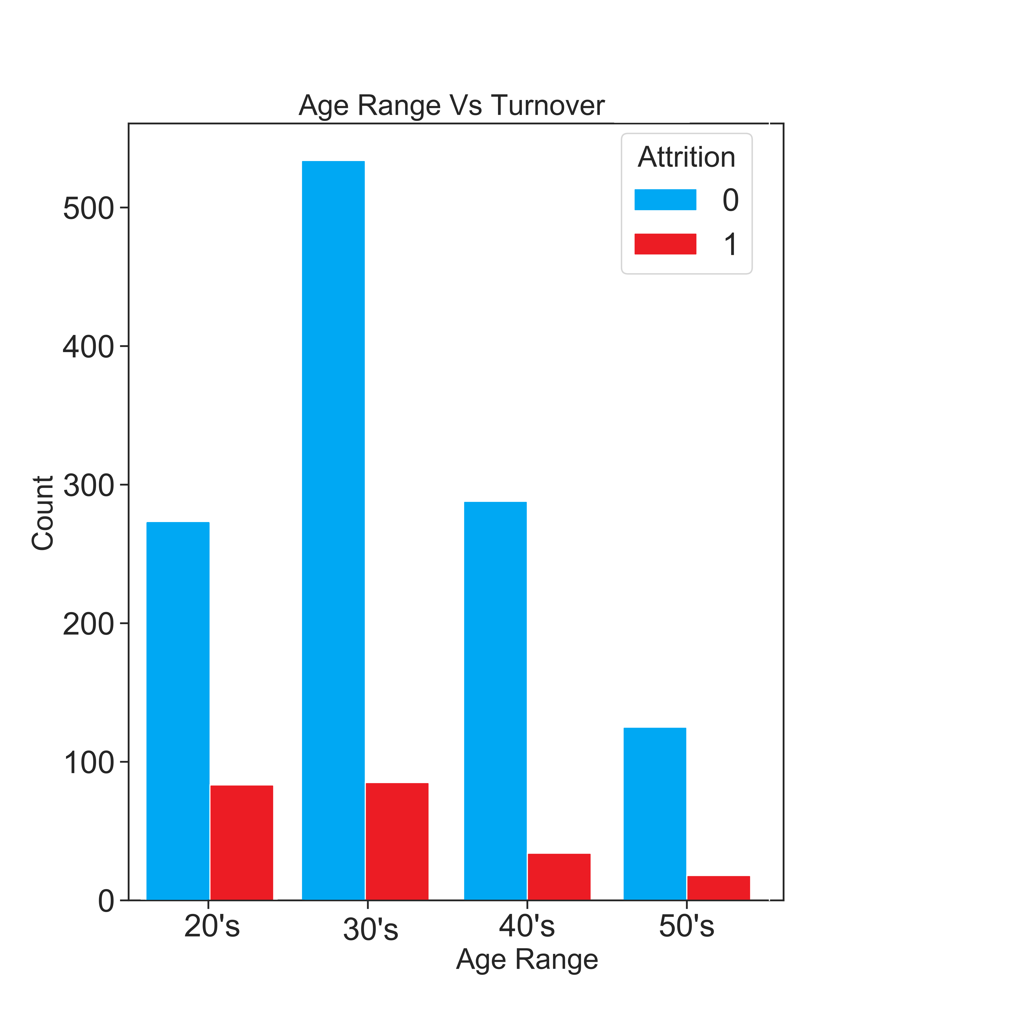
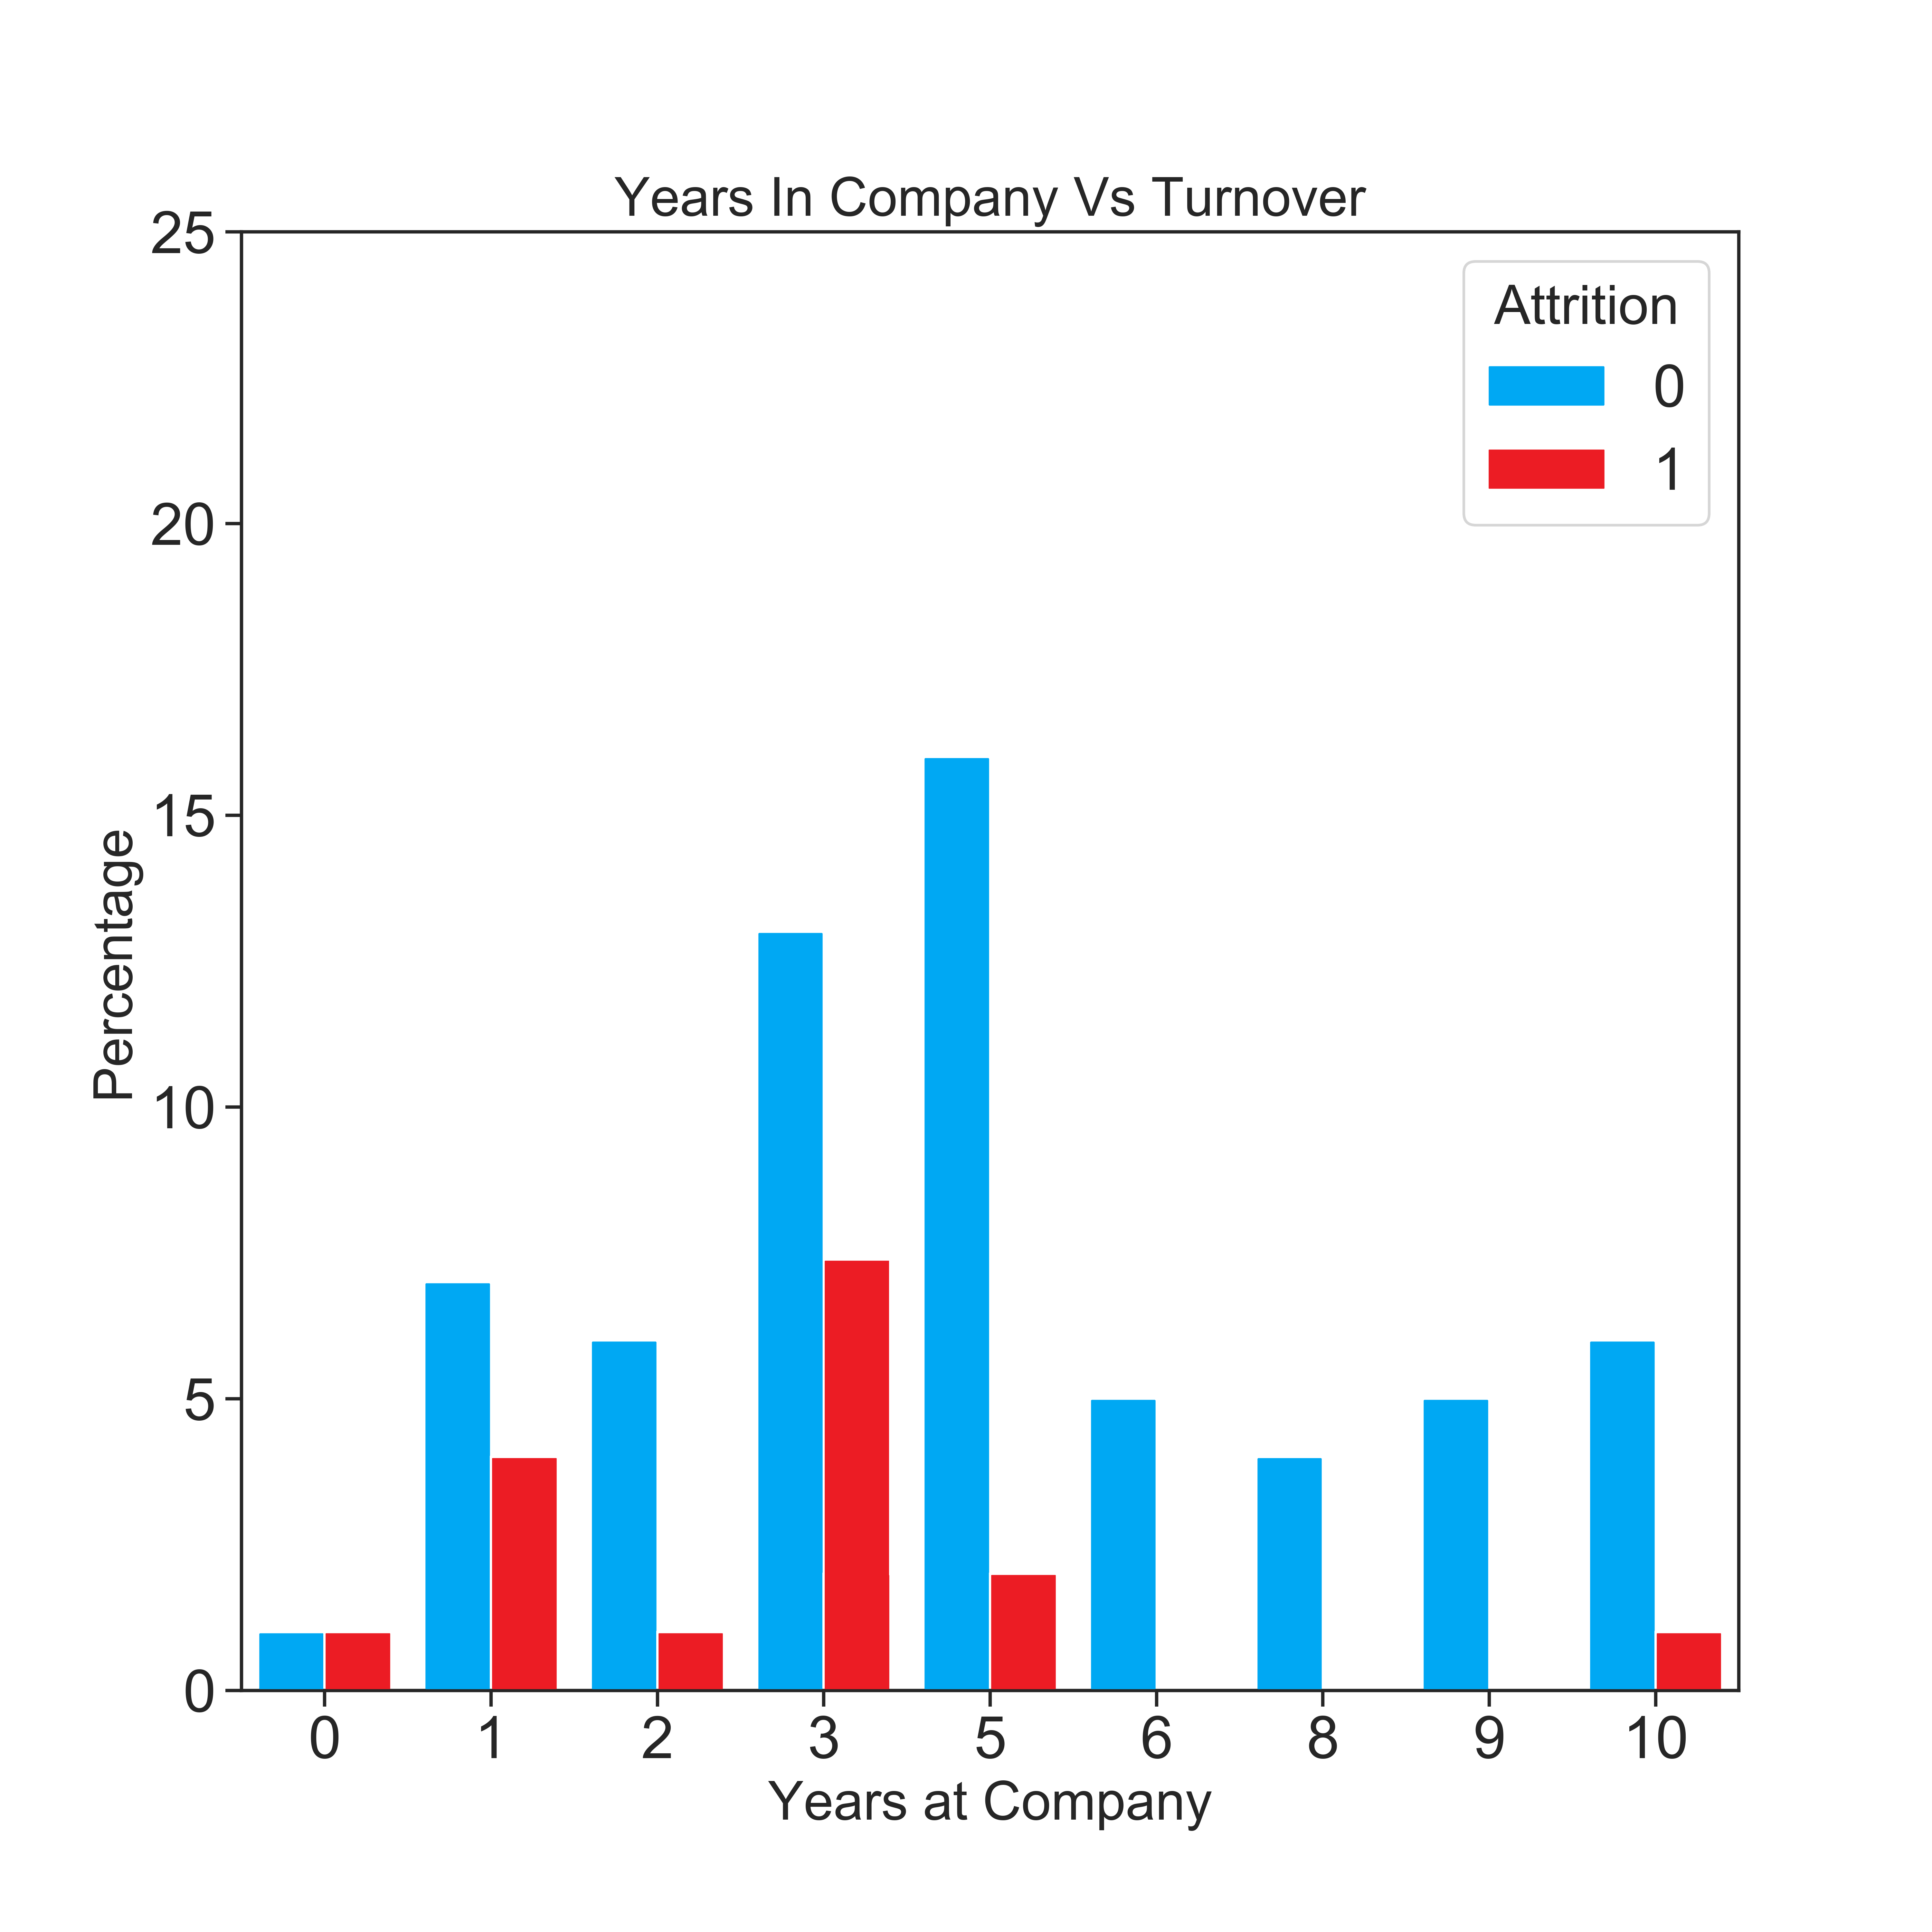
Inspection of Top Three Features
Salary
AGE
Years at Company
Sub-Categories of Highest Turnover
Low Salaried Employees
Individuals in their 20’s and 30’s
Being Employed at the Company for 3 Years
Notes:
Upon further inspection of the top three features we see that the sub-categories of highest attrition are, low salaried employees, individuals in their 20s and 30s, and individuals who are employed at the company for 3 years.

Slide 14
How This Affects The Bottom Line
Replacing a Salaried Employee:
Up to 20% of Salary for Entry-Level Positions
Up to 50% of Salary for Mid-Level Positions
Up to 125% of Salary for Senior-Level Positions
From Data - Most Turnover at Low Range Salary
~200 Employees Left * ( $11,880 - $88,068) *20%
Total Cost = ($475,200 - $3,522,720)
Important Features
Monthly Income
Years
At Company
Age
Total
Working Years
Distance
From Home
Notes:
An example of how this affects the bottom line. On average it takes 20% of entry level salary to replace a salaried employee, 50% of salary for mid-level position, and %125 for senior level positions.
If we take all low salary employees who left, 200 of them and calculate the total cost of replacing them, that is between $475,000 on the low end upwards to 3 and a half million dollars on the high end.
It’s important that your organization identifies employees who are leaving in order to potential reduce the financial impact on your companies bottom line. Let’s talk about how my product can help you reduced employee attrition.

Slide 15
THANK YOU

